Slide 1
MILESTONE 4
PERLSQUAD

Slide 2
Overview
Interactive learning game with multiplayer functions
Focus on science knowledge and literacy particularly the subject of biomes
Content that teaches and tests the user on new and learned information
Fun learning based interactions with an online environment

Slide 3
Concept Map

Slide 4
Usecase
Intended Users:
College students learning to teach with games
Teachers using games to teach
Middle-school-aged-or-younger students
https://docs.google.com/document/d/1e5ascPfpUYNgMeVOGlHXDKpqkCt7XNQYhvupM8mXoGY/edit?usp=sharing

Slide 5

Revised Technology Stack
CreateJS - uses JavaScript and HTML5 Canvas
EaselJS
TweenJS
SoundJS
PreloadJS
Photoshop/GIMP to edit art assets for the game

Slide 6
Revised Technology Stack - EaselJS
EaselJS - Used to create simple graphics like lines and boxes for an HTML5 canvas.
http://createjs.com/getting-started/easeljs

Slide 7
Revised Technology Stack - EaselJS Classes
AlphaMapFilter
AlphaMaskFilter
Bitmap
BitmapText
BlurFilter
ButtonHelper
ColorFilter
ColorMatrix
ColorMatrixFilter
Container
DisplayObject
DisplayProps
DOMElement
EaselJS
Filter
Graphics
Graphics.Arc
Graphics.ArcTo
Graphics.BeginPath
Graphics.BezierCurveTo
Graphics.Circle
Graphics.ClosePath
Graphics.Ellipse
Graphics.Fill
Graphics.LineTo
Graphics.MoveTo
Graphics.PolyStar
Graphics.QuadraticCurveTo
Graphics.Rect
Graphics.RoundRect
Graphics.Stroke
Graphics.StrokeDash
Graphics.StrokeStyle

Slide 8
Revised Technology Stack - EaselJS Classes(Cont.)
Matrix2D
MouseEvent
MovieClip
MovieClipPlugin
Point
Rectangle
Shadow
Shape
Sprite
SpriteContainer
SpriteSheet
SpriteSheetBuilder
SpriteSheetUtils
SpriteStage
Stage
Text
Touch
UID

Slide 9
Revised Technology Stack - TweenJS
TweenJS - Used to animate HTML5 and JavaScript properties.
http://createjs.com/getting-started/tweenjs

Slide 10
Revised Technology Stack - TweenJS Classes
CSSPlugin
Ease
MotionGuidePlugin
SamplePlugin
Timeline
Tween
TweenJS

Slide 11
Revised Technology Stack - SoundJS
SoundJS - Used to efficiently work with HTML5 audio.
http://createjs.com/getting-started/soundjs

Slide 12
Revised Technology Stack - SoundJS Classes
AbstractPlugin
AbstractSoundInstance
AudioSprite
CordovaAudioLoader
CordovaAudioPlugin
CordovaAudioSoundInstance
FlashAudioLoader
FlashAudioPlugin
FlashAudioSoundInstance
HTMLAudioPlugin
HTMLAudioSoundInstance
HTMLAudioTagPool
PlayPropsConfig
Sound
SoundJS
WebAudioLoader
WebAudioPlugin
WebAudioSoundInstance

Slide 13
Revised Technology Stack - PreloadJS
PreloadJS - Used to manage and co-ordinate the loading of assets.
http://createjs.com/getting-started/preloadjs

Slide 14
Revised Technology Stack - PreloadJS Classes
AbstractLoader
AbstractMediaLoader
AbstractRequest
BinaryLoader
CSSLoader
DataUtils
DomUtils
ImageLoader
JavaScriptLoader
JSONLoader
JSONPLoader
LoadItem
LoadQueue
ManifestLoader
MediaTagRequest
PreloadJS
ProgressEvent
RequestUtils
SamplePlugin
SoundLoader
SpriteSheetLoader
SVGLoader
TagRequest
TextLoader
VideoLoader
XHRRequest
XMLLoader

Slide 15
Why CreateJS Over Scratch
CreateJS is more powerful.
CreateJS is widely used and highly supported.
CreateJS has many helpful tutorials.
While game editing was one of the key advantages Scratch held over CreateJS, editing with Scratch is still not user-friendly enough for non-”tech-savy” people.
Creating our own editing aspect in-game using CreateJS allows us more control over how games are edited.

Slide 16
Revised MVP
‘Board Game’-based, biome-themed single/multiplayer game w/ 5 biomes, each with 6 biome objects (3 animal, precipitation, temp and growing season) to be collected and placed into their respective biomes at end-game.
At least one type of minigame to be played each time player collects object for biome.
Options menu with ability to edit game by adding or removing aspects

Slide 17
Revised Sprints
Sprint 1: Storyboard game concepts and find game engine, images, etc. to create game.
Sprint 2: Create individual game modules to be combined together for working game.
Sprint 3: Combine and unify modules.
Sprint 4: Add remaining content/modules to meet or exceed MVP.

Slide 18
Sprint 4 - Individual Responsibilities
Eric Keep: Implement demo minigame with image library
Robert Smith: Add to image library for demo minigame
Favour Ogundare: implement demo minigame with image library
Alex Mayle: Finalize game engine by merging modules
Brian Reynolds: Create information pages and tutorials for minigames

Slide 19
Storyboard
Game will be broken up into 4 modules:
Main Menu:
User(s) select # of players and change options
Game Board:
Player(s) traverse and learn about biomes.
Minigames:
Checkpoints for player(s) to collect biome objects.

Slide 20
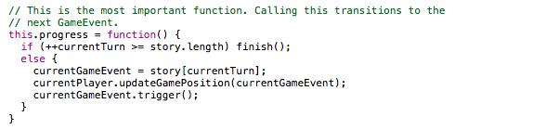

Implementation Details

Slide 21
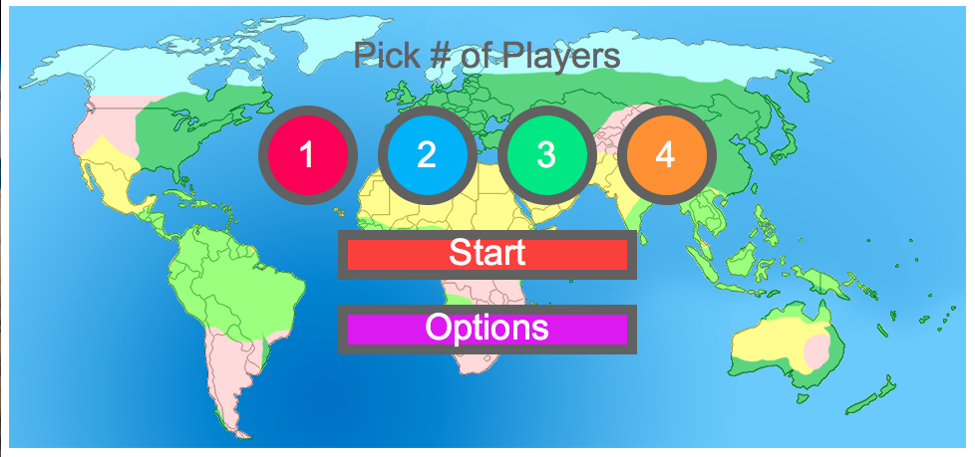
Screenshots - Start Menu

Slide 22
Gitlog - Alex

Slide 23
Gitlog - Brian

Slide 24
Gitlog - Eric

Slide 25
Gitlog - Favour

Slide 26
Gitlog - Robert

